Slide 1
Theory of Automata
Shakir Ullah Shah
Lecture 5

Slide 2
FA and their Languages
We will study FA from two different angles:
1. Given a language, can we build a machine for it?
2. Given a machine, can we deduce its language?
Note:
Every state has as many outgoing edges as there are letters in the alphabet.
It is possible for a state to have no incoming edges or to have many.
FAST National University of Computer and Emerging Sciences, Peshawar Campus

Slide 3
(a + b)*
FAST National University of Computer and Emerging Sciences, Peshawar Campus

Slide 4
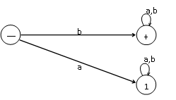
starting with b=b(a + b)*
FAST National University of Computer and Emerging Sciences, Peshawar Campus

Slide 5

ending in a=(a+b)*a
FAST National University of Computer and Emerging Sciences, Peshawar Campus

Slide 6

(a+b)(a+b)*
FAST National University of Computer and Emerging Sciences, Peshawar Campus

Slide 7
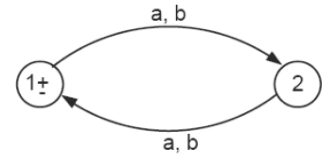
Even length
FAST National University of Computer and Emerging Sciences, Peshawar Campus

Slide 8
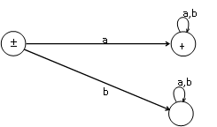
not beginning with b=
a(a + b)* + Λ
FAST National University of Computer and Emerging Sciences, Peshawar Campus

Slide 9
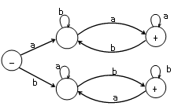
beginning with and ending in same letters. a(a + b)*a + b(a + b)*b
FAST National University of Computer and Emerging Sciences, Peshawar Campus

Slide 10
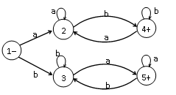
beginning with and ending in different letters. a(a + b)*b + b(a + b)*a
FAST National University of Computer and Emerging Sciences, Peshawar Campus

Slide 11

containing double a=(a+b)* (aa) (a+b)*.
FAST National University of Computer and Emerging Sciences, Peshawar Campus

Slide 12
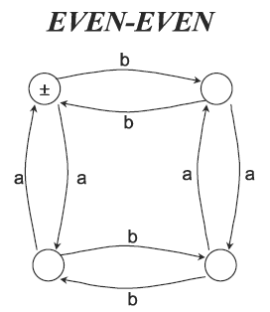
FAST National University of Computer and Emerging Sciences, Peshawar Campus

Slide 13
a(a + b)*
FAST National University of Computer and Emerging Sciences, Peshawar Campus

Slide 14
(a + b)*(aa + bb)(a + b)*
FAST National University of Computer and Emerging Sciences, Peshawar Campus

Slide 15
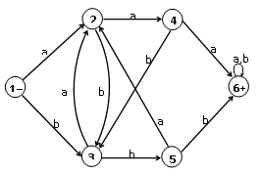
containing a triple letter, either aaa or bbb
FAST National University of Computer and Emerging Sciences, Peshawar Campus

Slide 16

FAs that accept no language
There are FAs that accept no language. These are of two types:
The first type includes FAs that have no final states, such as
FAST National University of Computer and Emerging Sciences, Peshawar Campus

Slide 17
FAs that accept no language
The second type include FAs of which the final states can not be reached from the start state.
This may be either because the diagram is in two separate components. In this case, we say that the graph is disconnected, as in the example below:
FAST National University of Computer and Emerging Sciences, Peshawar Campus

Slide 18
Or it is because the final state has no incoming edges, as shown below:
FAST National University of Computer and Emerging Sciences, Peshawar Campus

